Slide 1

Facial Emotion Detector
User Manual
Author: Srishti Vipin K
Notes:
Preworks course home assignments

Slide 2
Table of Contents
Acknowledgements
About Me
My Journey with Clevered
About the App
How to Use it?
-Demo Video
-Toolkit Walkthrough
-Contact Person

Slide 3
Acknowledgements
A small vote of thanks for all who have helped you in this journey of App Development – your parents, Mentors,Dr. Ken Khan, Sites etc.

Slide 4

About Me..
Student’s Photograph
I am Srishti Vipin, I'm a creative individual with a passion for artificial intelligence. As a house captain and football team member, I thrive in collaborative environments while maintaining a strong work ethic.

Slide 5
About My Internship Journey with Clevered..
My journey into AI began with Clevered's online internship program. As someone fascinated by the intersection of technology and human emotion, I was immediately drawn to the face emotion detection project.
Throughout the internship, I had the incredible opportunity to be mentored by Ms.Mani. Their guidance proved invaluable.
The experience not only equipped me with the technical skills to build a face emotion detector, but also fostered a deeper understanding of the potential of AI in various fields. I'm incredibly grateful to Clevered and especially to Ms.Mani for making this journey so rewarding.

Slide 6
About App..
Uses
Improving human-computer interaction by allowing computers to respond to users' emotions
Analyzing customer emotions in marketing studies
Studying emotional responses in psychology experiments
This app demonstrates facial emotion detection using a pre-trained machine learning model. Colab was used to develop and train the model.
https://colab.research.google.com/drive/1vE3JmpHqN9_NyXkTVWmMiE5KI3cMmtRU#scrollTo=Nk0d6Hdb9SGj

Slide 7
How do I use the App?

Slide 8
Facial Emotion Detector
Web-based app: My project runs on a website google colab, you'll be able to use it from any device with a web browser and internet connection. Just visit the provided link
Webcam access: If your app uses a webcam for real-time detection, you might need to grant it permission to access your camera. This is usually a one-time step during your first use.
The app might display a live video feed from your webcam.You might position your face within a designated area on the screen and fix the lighting. There is a button to click the image.
After a brief processing time, the app should display the detected emotion(s) on the screen, likely overlaid on the image or video feed.
**note Face emotion detection is a complex field, and results should be interpreted for entertainment purposes only. They may not accurately reflect true emotions.

Slide 9
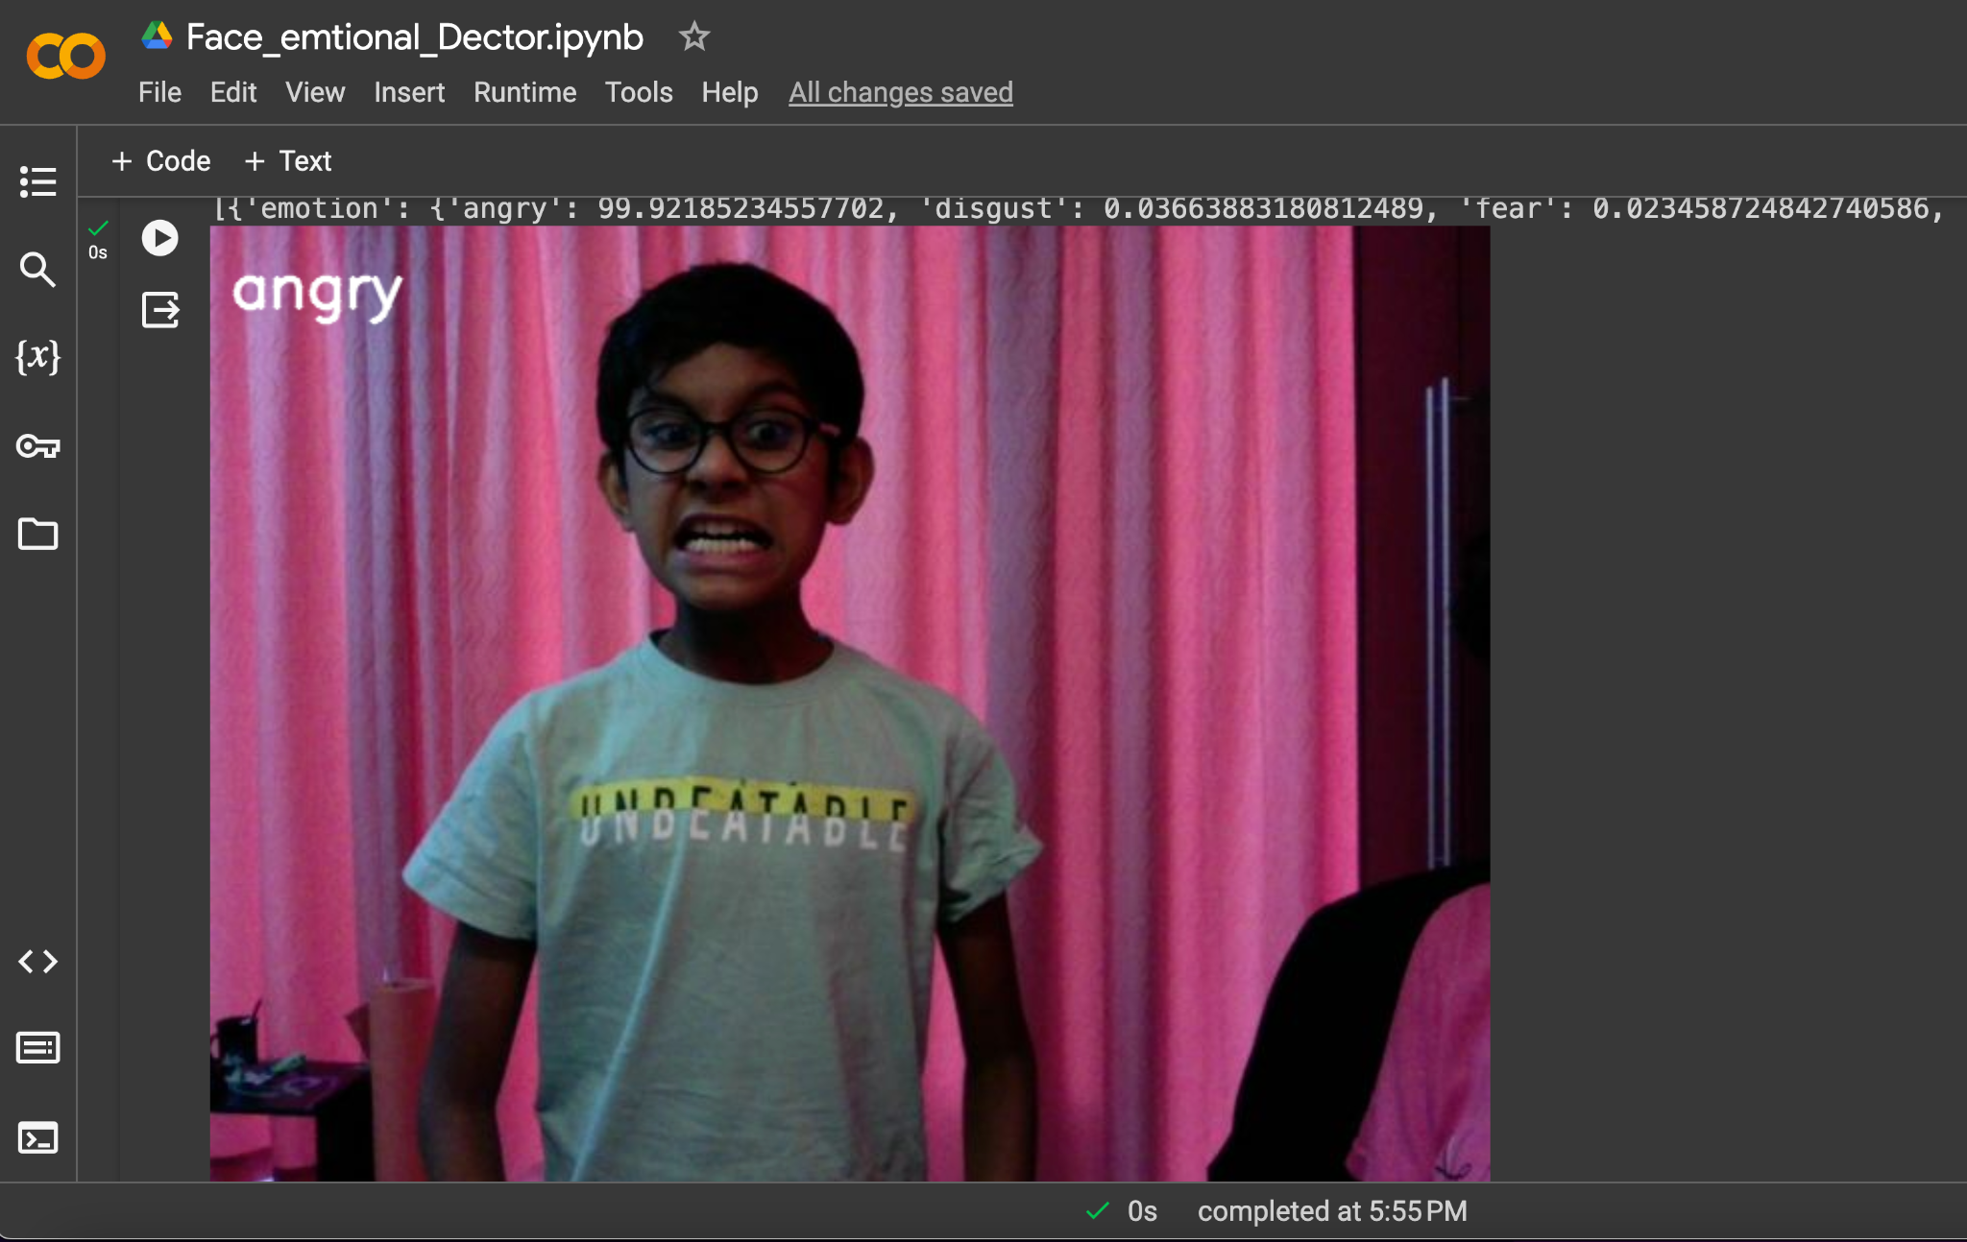
*my brother

Slide 10
Demo Video
Demo any 2 features/ functions/ options of your project. Make a recording of the same and attach here as a backup if needed

Slide 11
Toolkit Walkthrough
Link

Slide 12
Contact Person
srishtivkumar@gmail.com

Slide 13
Thank you!

